Slide 1
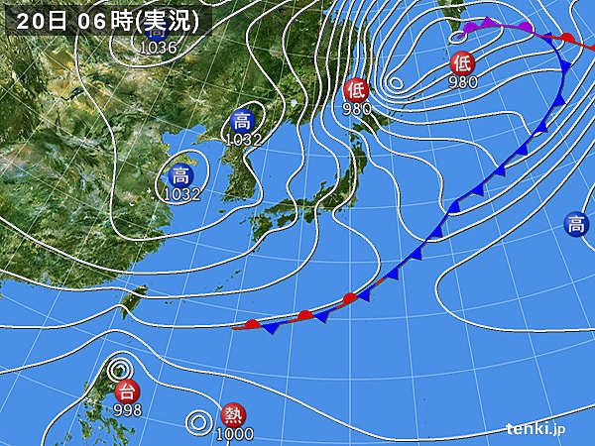
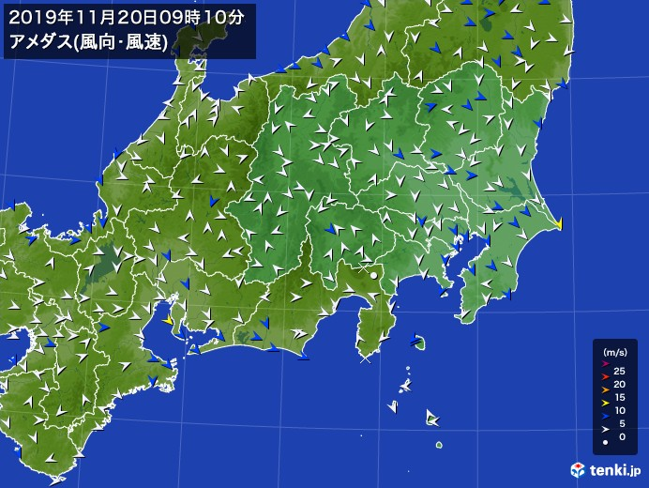
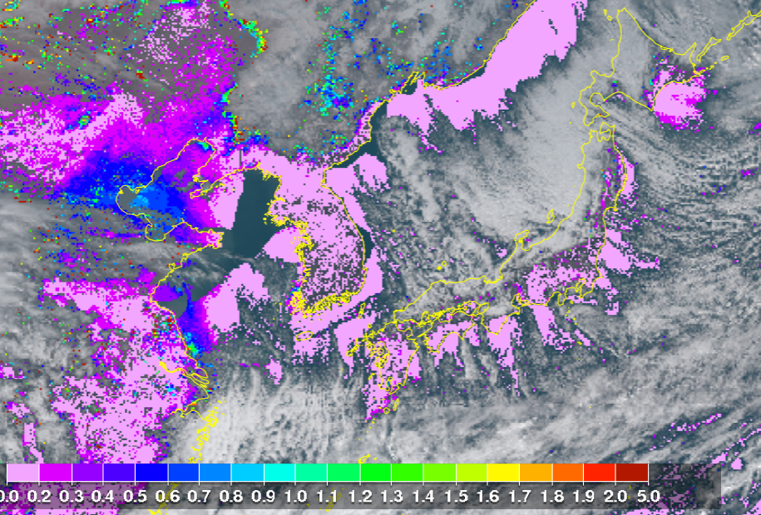
Winter comes? (Nov. 20)
Himawari monitor
Nov. 20 12:30
AOT

Slide 2
Cloud base height (Nov. 19-20)
cloud base @~2-3 km

Slide 4
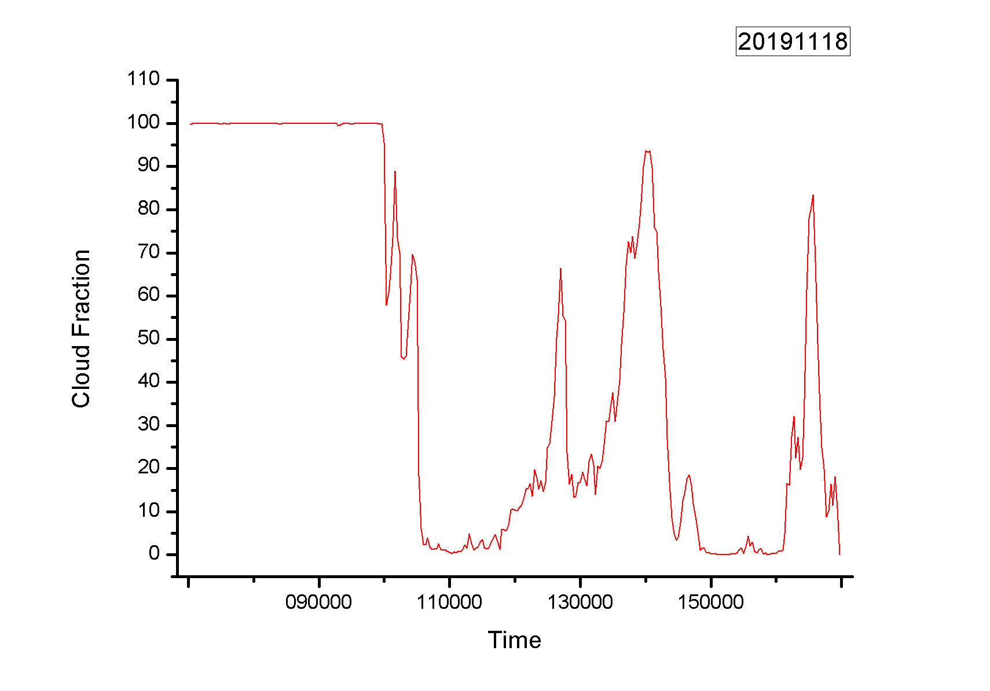
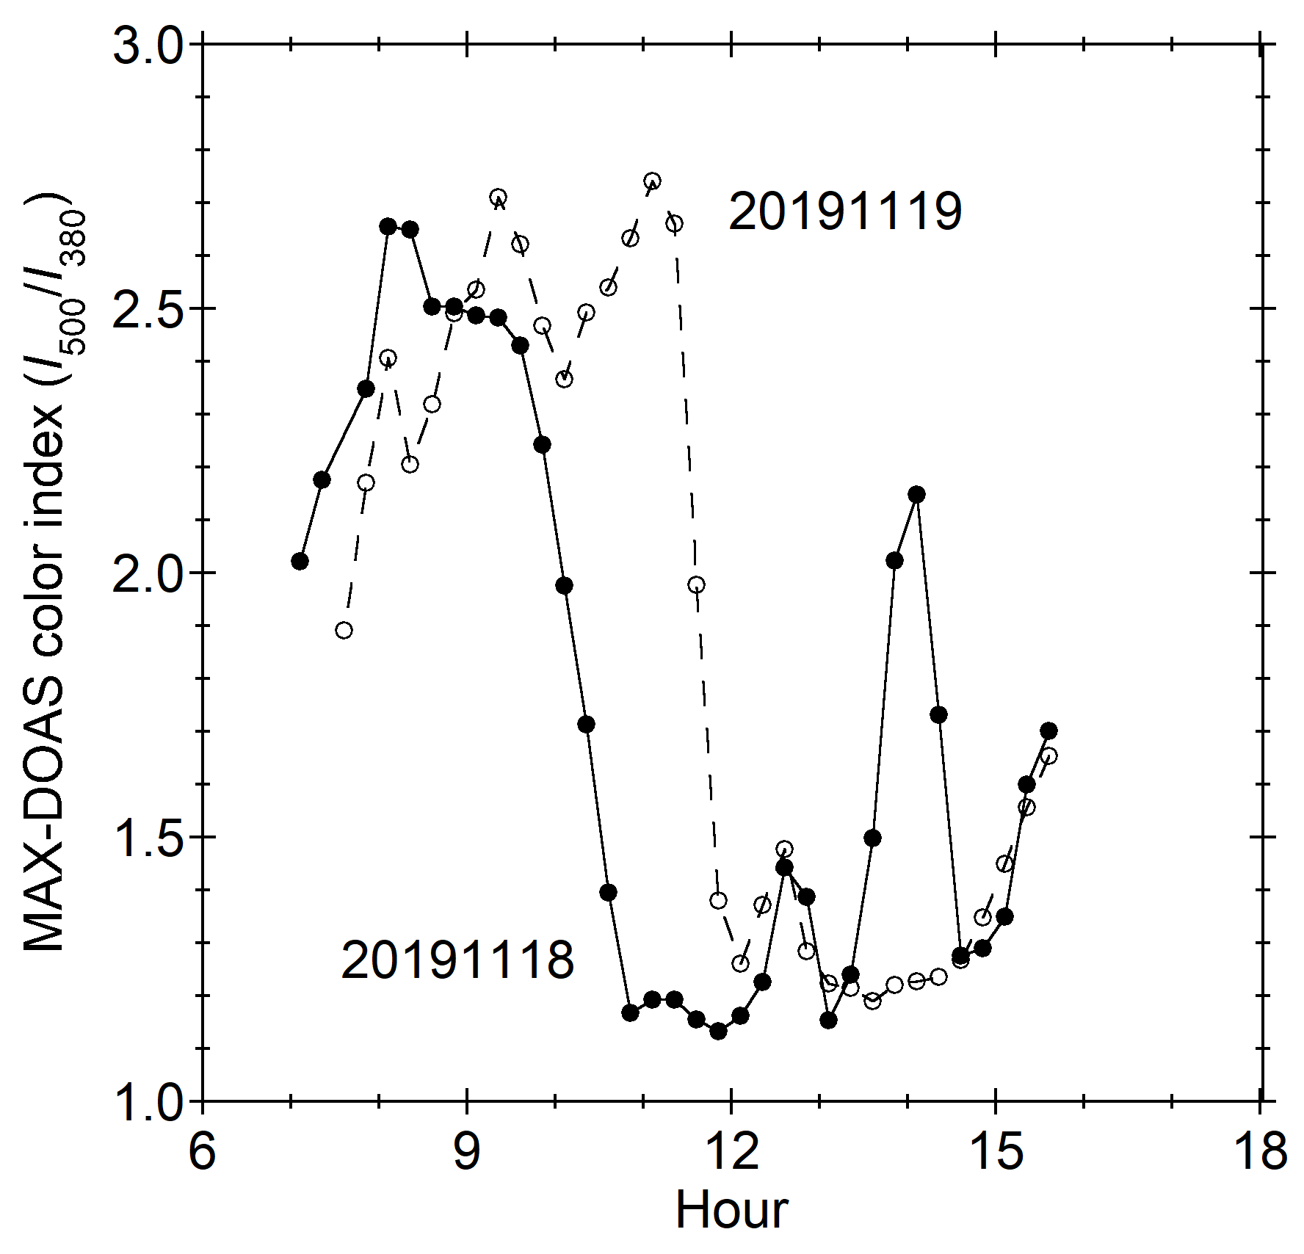
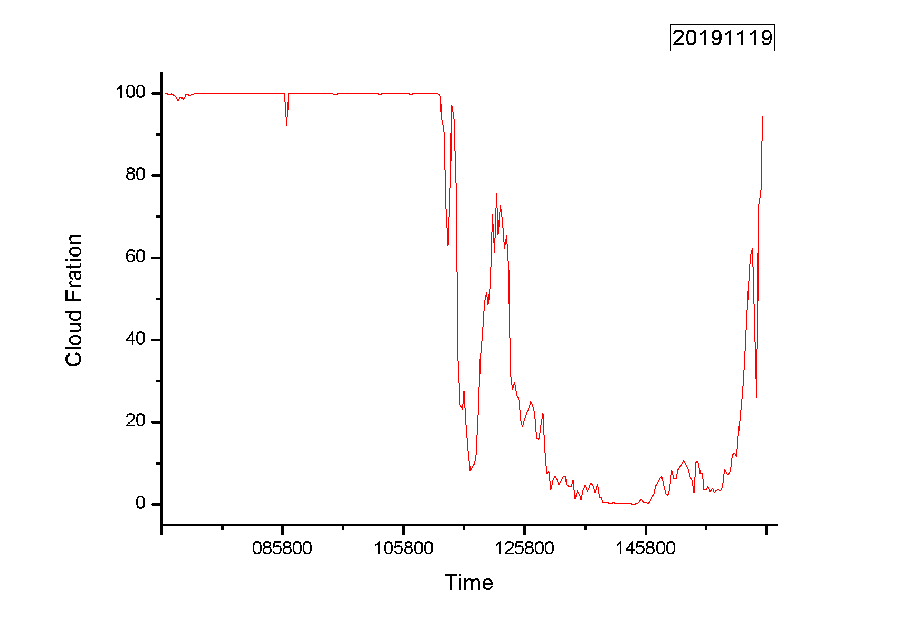
MAX-DOAS color index (Nov. 18-19)
Color index:
Ratio of measured reference spectrum intensities at 500 and 380 nm
Xie-san’s cloud fraction estimates

Slide 6
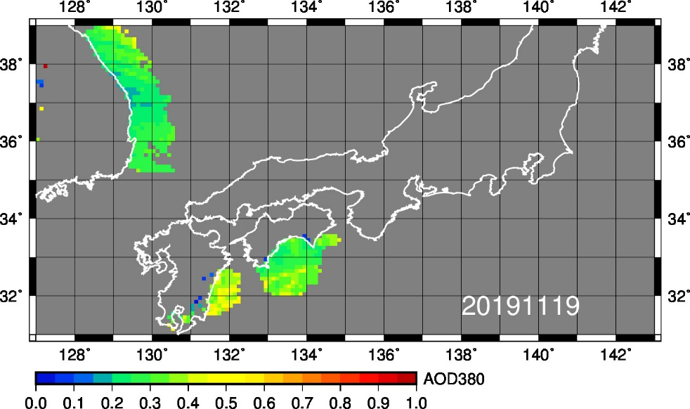
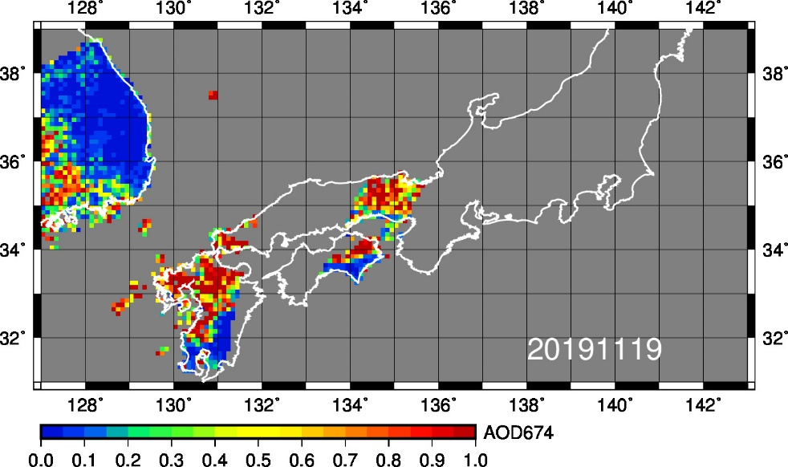
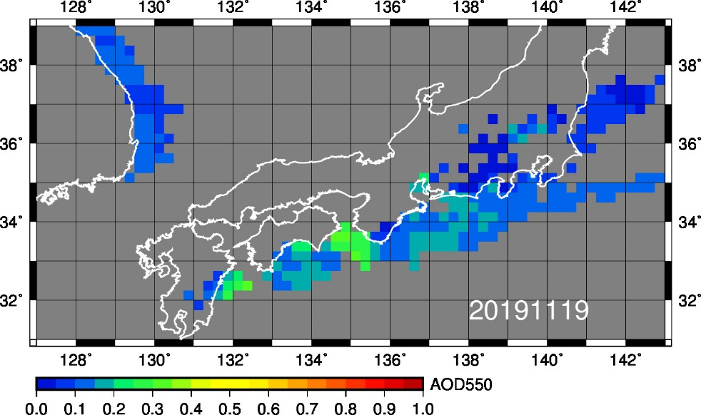
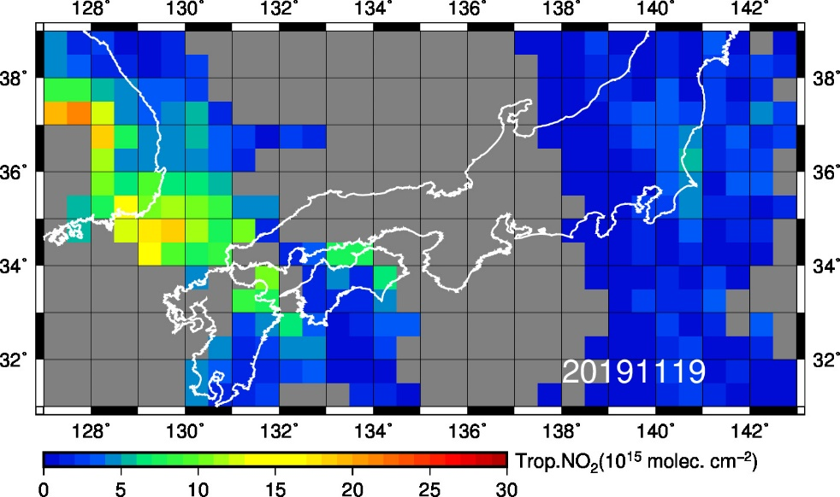
Satellite data of AOT and NO₂
(20191119)
GCOM-C AOT380
GCOM-C AOT674
MODIS AOT550
OMI NO2 VCD

